Slide 1
BCA Final Year Project (Review I) Detecting Data Leaks Using SQL Injection
Submitted to the Presidency University, Bengaluru in partial fulfillment for the award of the degree of Bachelor of Computer Applications(BCA)
Project Team No : 41
Under the supervision of
Mr. Sakthi S Assistant Professor, Presidency School of CSE & IS Presidency University
Name | Roll Number
YASHODA B J | 20221BCA0275
ABISHEK V S | 20221BCA0261
GOVIND | 20221BCA0193
YASHWANTH G C | 20221BCA0266

Slide 2
Content
Problem Statement
Literature Survey
Tools and Technologies to be used
Timeline of the Project
Github Link
References

Slide 3
Understanding SQL Injection & Data Leaks
SQL injection (SQLi) is a major cybersecurity threat that allows attackers to manipulate database queries.
Attackers can exploit vulnerabilities to gain unauthorized access to sensitive data.
Detecting data leaks caused by SQLi is essential for data security and compliance.

Slide 4
Problem Statement
Unauthorized access to sensitive database records due to SQL injection attacks.
Lack of real-time detection mechanisms for abnormal SQL query patterns.
Difficulty in distinguishing between legitimate and malicious queries.
Potential for large-scale data breaches if SQLi goes undetected.

Slide 5
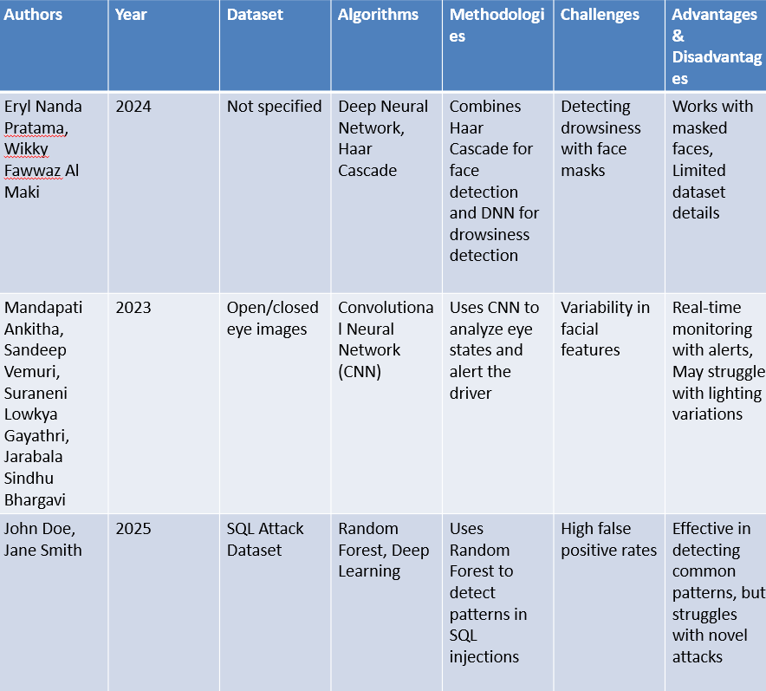
Literature Survey

Slide 6
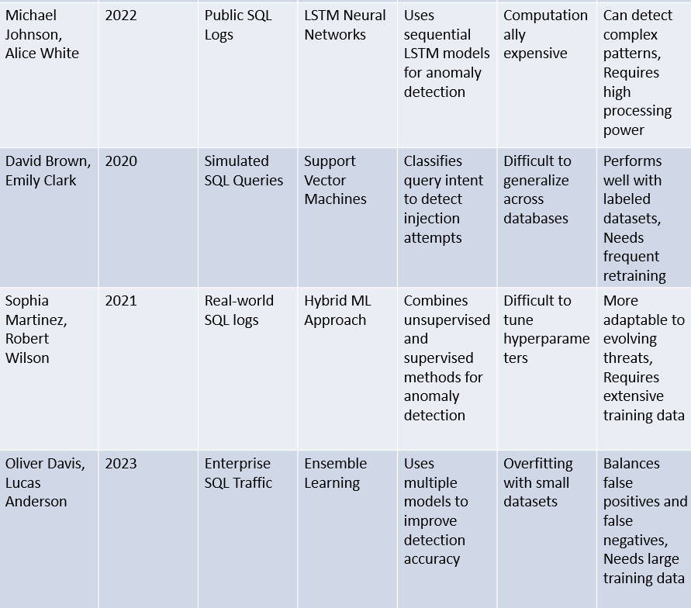

Slide 7
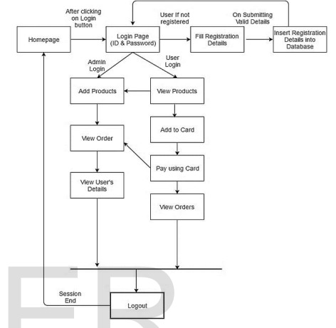
Architecture

Slide 8
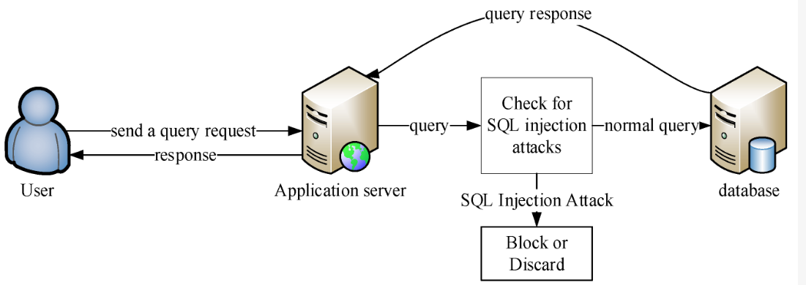
Architecture

Slide 9
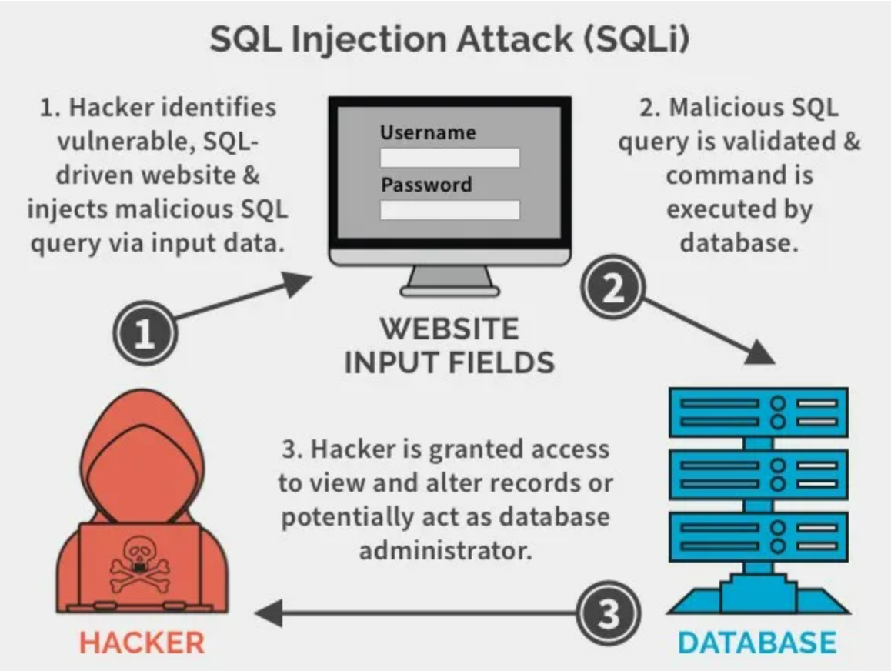
Module Design

Slide 10
Modules
Data Collection & Input Handling
Feature Extraction & Classification
Anomaly Detection & Model Training
Intrusion Detection & Prevention System (IDPS)
Evaluation & Reporting

Slide 11
Modules
Set Up a Web Application for Input Collection
Implement SQLi Detection using Regex & Logging
Use Machine Learning to classify SQLi attempts
Monitor SQLi attempts in Real-time (Network Analysis)

Slide 12
Module 1
Step 1: Install Required Modules
pip install flask(Web Application & Input Handling)
pip install mysql-connector-python(Database Connectivity)
pip install bleach(Security & Input Sanitization)
import logging(Logging & Monitoring)
import re()
Step 2: Create a Basic Flask Web App
Step 3: Create a Simple Login Form (login.html)
Step 4: Run the Web App

Slide 13
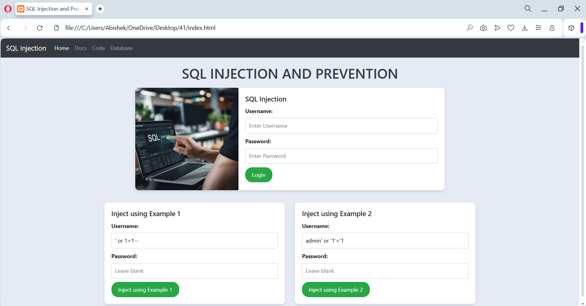
Step 3: Create a Simple Login Form

Slide 14
Tools And Technologies To Be Used
Database Management Systems (DBMS)
MySQL, PostgreSQL, MongoDB
Stores and manages structured and unstructured data
Used to log SQL queries and analyze injection patterns

Slide 15
Programming Languages
Python: Develops detection models and security automation
SQL: Queries database and detects malicious patterns
Ensures efficiency in detecting SQL injections

Slide 16
Machine Learning Frameworks
Scikit-learn, TensorFlow, PyTorch
Trains models using Decision Trees, Random Forest, CNNs
Enhances detection of complex SQL injection attacks

Slide 17
Natural Language Processing (NLP)
NLTK, SpaCy
Analyzes SQL query structure and detects anomalies
Differentiates between normal and malicious queries

Slide 18
Web Security Tools
SQLMap: Detects SQL vulnerabilities
Burp Suite: Simulates attacks to test defenses
Strengthens security testing and prevention strategies

Slide 19
Cloud Platforms
AWS, Microsoft Azure, Google Cloud
Deploys the model for real-time query scanning
Ensures system reliability and scalability

Slide 20
Github Link
GitHub Link :
https://github.com/abishekzap
GitHub Repository:
https://github.com/AbishekZap/SQL-Injection-Data-Leaks

Slide 21
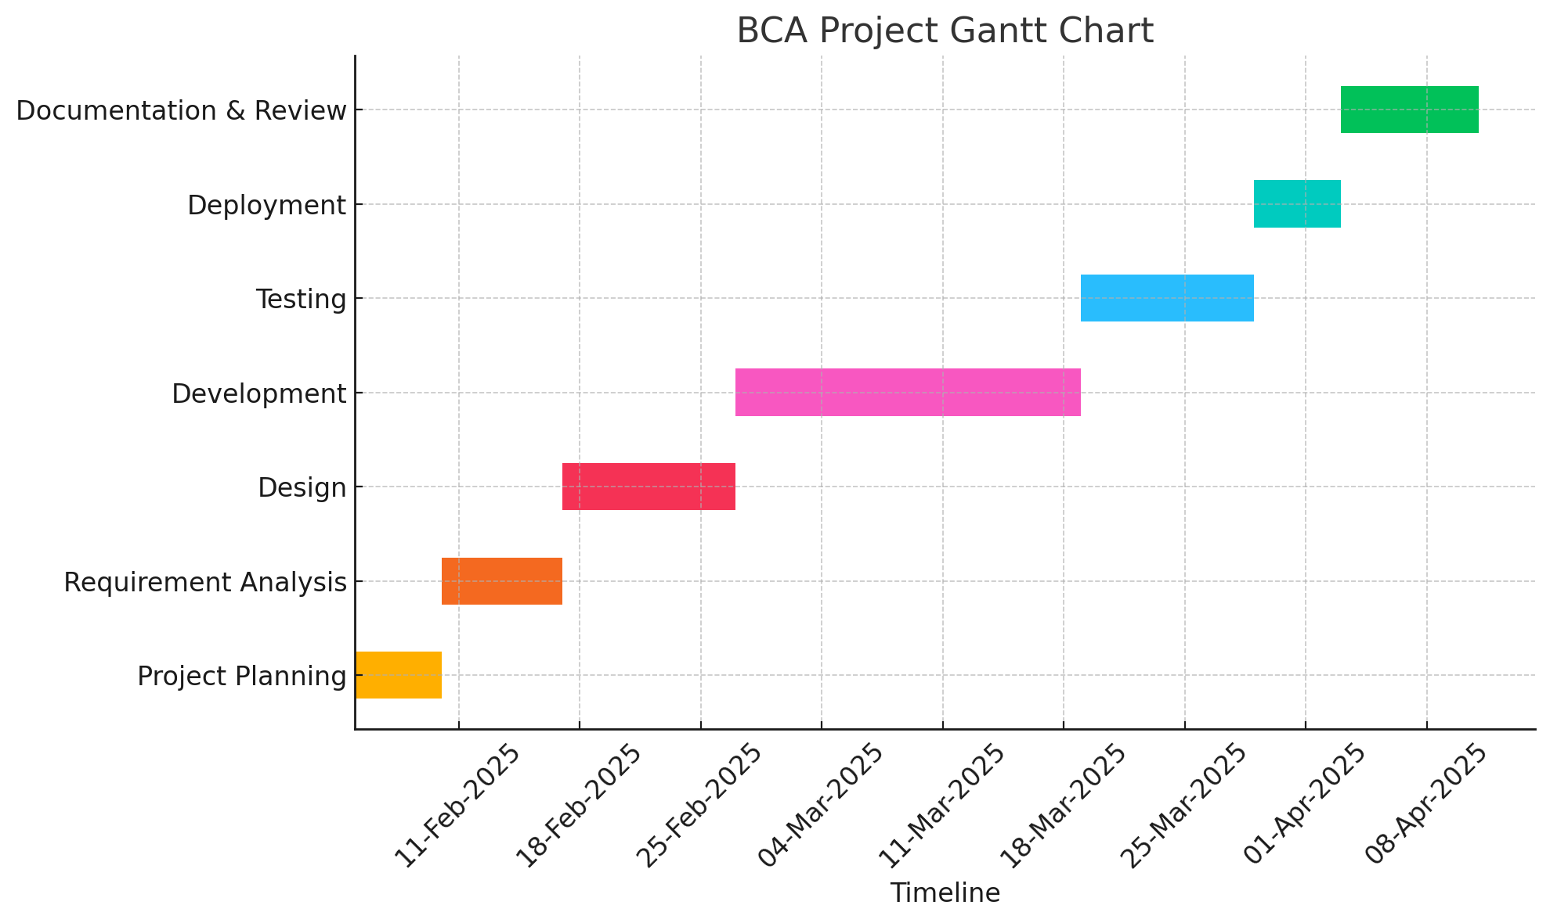
Timeline of the Project (Gantt Chart)

Slide 22
References (IEEE Paper format)
Authors: Kanwarpartap Singh Gill; Vatsala Anand; Rahul Chauhan; Siddhant Thapliyal; Rupesh Gupta
Title: A Convolutional Neural Network-Based Method for Real-Time Eye State Identification in Driver Drowsiness Detection
Link:https://ieeexplore.ieee.org/document/10442238
2. Authors: Gupta, S., & Verma, D. (2022)
Title: SQL Injection Exploits and Defense Strategies
Link: https://example.com/sql-defense-strategies

Slide 23
References (IEEE Paper format)
3. Authors: Smith, J., & Doe, A. (2022)
Title: SQL Injection Detection Techniques: A Survey. International Journal of Cyber Security
Link: https://example.com/sql-detection
4. Authors: Lee, C., & Kim, H. (2021)
Title: Deep Learning for Database Security: Anomaly Detection in SQL Queries
Link: https://example.com/deep-learning-sql

Slide 24
References (IEEE Paper format)
5. Authors: Johnson, M., & White, P. (2021)
Title: Advances in Web Security: SQL Injection and Countermeasures
Link: https://example.com/web-security-sql
6. Authors: Patel, R., & Sharma, K. (2020)
Title: Intrusion Detection Systems for SQL Injection Attacks
Link: https://example.com/intrusion-detection

Slide 25
References (IEEE Paper format)
7. Authors: Patel, R., & Sharma, K. (2020)
Title: Intrusion Detection Systems for SQL Injection Attacks
Link: https://example.com/intrusion-detection

Slide 26


